Slide 1
Microsoft Purview Accelerator
Delivery Guide

Slide 2
What is the Microsoft Purview Accelerator
The Microsoft Purview Accelerator is a one-day event which can be delivered by Microsoft partners, Microsoft field, or Microsoft Global Partner Solutions (GPS) to help land the value proposition of Microsoft Purview.
The event kicks-off with a high-level overview of the Microsoft Purview service through the delivery of a PowerPoint presentation with an optional live demonstration, followed by participants being split into evenly distributed breakout rooms to work through hands-on exercises. Once in a breakout room, participants are greeted by a proctor (Microsoft Purview Accelerator SME), who will support the team's completion of the core modules.
Throughout the day, participants will have the opportunity to validate their learning through knowledge checks and ask questions to their aligned proctor and/or within the main group.

Slide 3
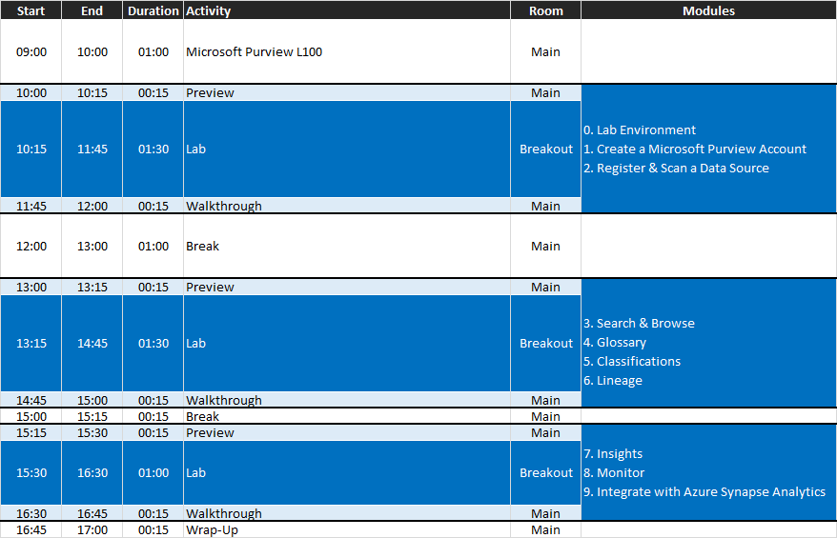
Timings
Main
Room 1
Room 2
Room 3
Room 4
Room 5
Room N
Main
Room 1
Room 2
Room 3
Room 4
Room 5
Room N
Main
Room 1
Room 2
Room 3
Room 4
Room 5
Room N
Main
Notes:
With the examples to date, we have been using the breakout rooms functionality within Microsoft Teams.
This could equally work using the Meet Now functionality within a channel (for example, create a channel per team, this has the added overhead of pre-creating teams).

Slide 4
On-site vs. remote delivery
The Microsoft Purview Accelerator workshop can be delivered remotely through online meetings or on-site.
On-site
Higher levels of engagement (more focused, less distracted).
Logistically more complex, difficult to scale to large numbers.
Remote delivery
Logistically simpler, easier to scale to large numbers.
Challenging to keep high levels of engagement (less focused, more distracted).
Notes:
Channel
Will you be running this In-Person or Online?
In-Person: [-] Scale [+] Engagement
Online: [+] Scale [-] Engagement
If online, you will require a platform (such as Teams Meeting) that enables bi-directional communication so people can share screen, ask questions, use audio/video, etc.

Slide 5
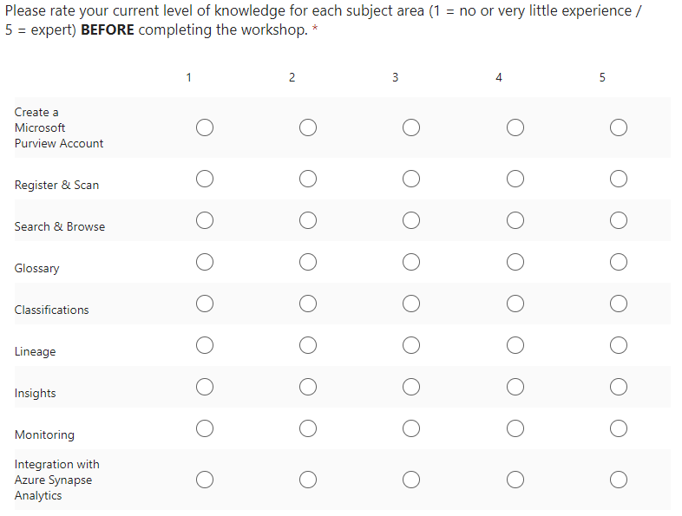
Pre-Lab Survey
A pre-lab survey can help establish a baseline prior to the completion of the workshop.

Slide 6
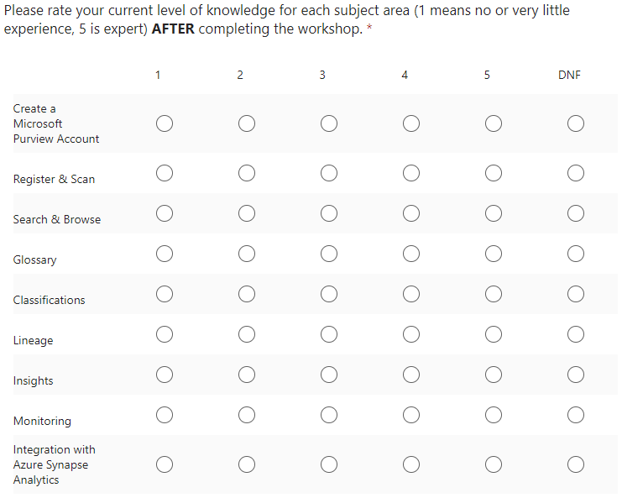
Post-Lab Survey
A post-lab survey can provide insights towards overall experience, opportunity to gather feedback, and help provide a view on impact.

Slide 7
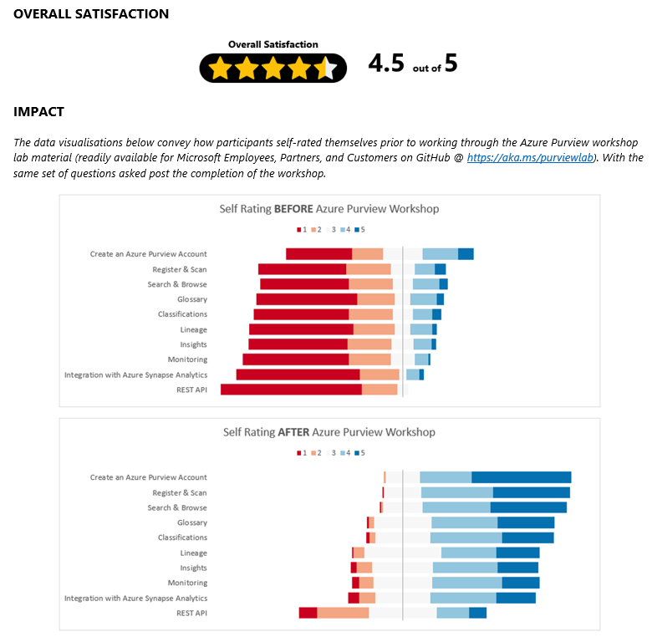
Impact
The data collected from the pre and post event surveys can be used to gauge overall satisfaction and how far participants feel they have progressed across covered topic areas.

Slide 8
Back channel
If you are delivering a remote version of the Microsoft Purview Accelerator, creating a group chat (e.g. using Microsoft Teams) prior to the event, that can be used by the v-team in the lead up to coordinate logistics and on the day itself to support one another during delivery.
For example, a participant within one breakout room may ask a question that the aligned proctor is unsure of, the proctor can use the back channel to post the question to the wider v-team.

Slide 9
Proctor readiness and tips
Pre-Event
Self-complete and build a level of familiarity with the lab material.
Answer and build a level of familiarity with the knowledge checks.
During the event
Camera on (recommended, higher levels of engagement).
Break the ice (around the room, brief introductions – name, role, org, experience).
Reiterate instructions, remind participants to complete the knowledge checks at the end of each module, and explain how participants can request support.
Leverage the back channel when in need of assistance.

Slide 10
Participant pre-requisites
Checklist
Access to an active Azure subscription.
Sufficient permissions to register resource providers, deploy resources, and assign RBAC roles.
Option #1: Pre-provisioned Lab Environments (e.g. resource group per participant)
High convenience, lab environment ready to go, more time learning.
Cost of running the lab environments with the delivery partner.
Option #2: BYO Azure Subscriptions
Cost of running lab environment in participant subscription.
Proctors may have to contend with a variety of issues as each person's access to a subscription is different. The impact of this may be reduced by requesting participants to spin up the lab environment ahead of the event.
Note: If participants do not have access to an Azure subscription, they can sign up for a free account at https://www.azure.com/free. See Azure free account FAQ for more details.

Slide 11
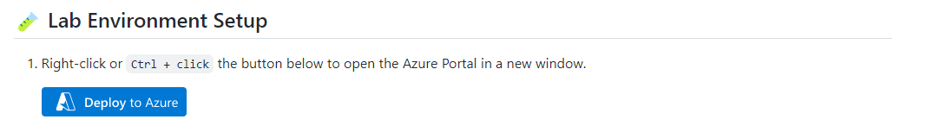
Lab environment
All the resources required to complete the modules are encapsulated as part of a single-click “Deploy to Azure” template under module Lab Environment Setup. Everything needed for the lab is deployed besides the Microsoft Purview account itself, this is intentional to ensure participants have an opportunity to step through the Microsoft Purview account creation process.
The cost of running the lab environment is approximately $10 USD per day.

Slide 12
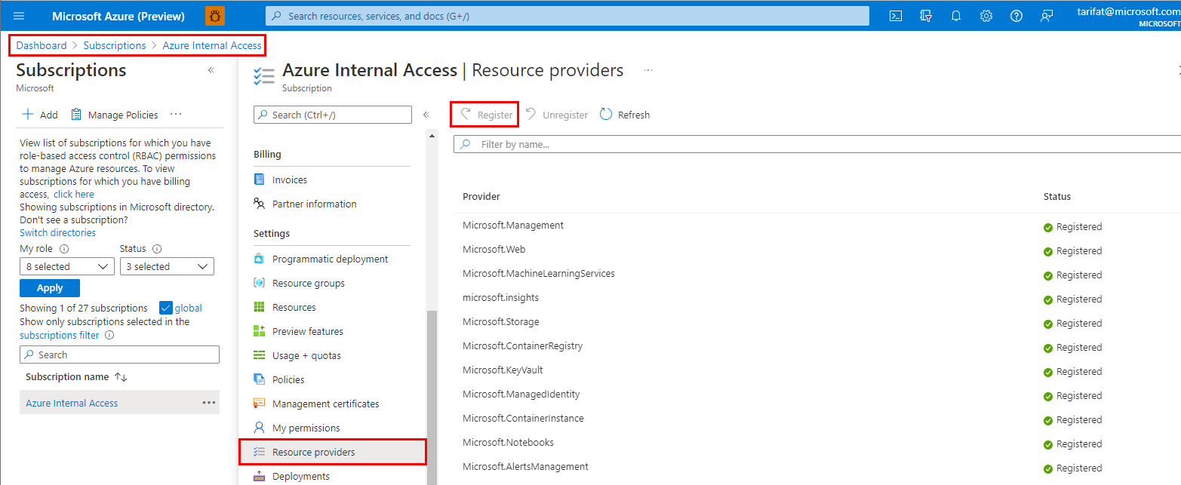
Gotcha #1: Resource providers
A common issue users typically face are “missing Resource Providers” (e.g. Microsoft.EventHub, Microsoft.Purview, etc).
Missing Resource Providers can be registered via:
Azure Portal > Subscriptions > YOUR_SUB > Resource Providers
Select the missing Resource Provider
Click [Register]

Slide 13
Gotcha #2: Quotas
There are a number of limits that exist in the Microsoft Purview service, these limits are also known as quotas and are documented here.
One particular limit to be aware of is that by default, a tenant (across all subscriptions combined), can have a maximum of 3 Microsoft Purview accounts per region.
With that in mind, if you are delivering a Microsoft Purview Accelerator event and a large number of Microsoft Purview accounts need to be provisioned within a single tenant, ensure to spread the deployments across different regions (e.g. 3 x Australia East, 3 x Brazil South, 3 x Canada Central, etc).

Slide 14
How to contribute
The content used to facilitate a Microsoft Purview Accelerator event is hosted on GitHub at aka.ms/purviewlab. The material is public and open-source, everyone is free to fork, clone, raise issues, submit pull requests, etc.
If you would like to contribute…
Fork the repository
Make changes to the version in your GitHub account
When ready, submit a pull request
Note: If you would like to add a completely new module, there is a boilerplate markdown file that can be used as a starting point under modules/template.md.

Slide 15

Pre-Event Checklist
Registration page (what, when, where)
Communications (email invite, 6-week lead time)
Establish v-team (rough guide 1 proctor:7 participant ratio)
Content familiarity (internal deadline)
Azure subscription readiness (BYO vs. pre-provisioned)
Pre/Post surveys generated (Microsoft Forms)
Establish back channel (online only)

Slide 16
On-Day Checklist
Deliver L100 Microsoft Purview high-level overview (slides and demo)
Request completion of pre-event survey
Participants complete core modules and knowledge checks
Request completion of post-event survey
Call to action

Slide 17
Lab Material Walkthrough
🤔Prerequisites
🧪Lab Environment Setup
📃Preface
📚Learning Modules - Core
📚Learning Modules - Optional

Slide 18
Knowledge Checks
Knowledge checks to be completed at the completion of each module.
Each individual must submit a knowledge check before proceeding to the next module.
Pay special attention to the Did you know snippets, these will help provide context for the Knowledge Check.

Slide 19
Knowledge Check #1
Which of the following Microsoft Purview pricing meters is serverless and used to support data map population through scanning and ingestion jobs?
A ) Capacity Units B ) vCore Hours C ) Neither
Which of the following Microsoft Purview pricing meters is always on and used to support data map consumption through capacity and storage?
A ) Capacity Units B ) vCore Hours C ) Neither
Which Microsoft Purview feature is included and billed with the consumption of the data map?
A ) Data Estate Insights B ) Search and browse of data assets C ) SQL DevOps access
Which predefined Microsoft Purview role provides access to manage data sources?
A ) Purview Data Reader B ) Purview Data Curator C ) Purview Data Source Administrator
vCore hours is the unit of measure for how we charge for scanning. As this is serverless compute, the meter is fluid. More information on the Azure Purview pricing page.
Capacity units is the unit of measure for how we charge for platform throughput. While the elastic data map controls how many customers need, the meter is always on as accounts require a minimum of 1CU. More information on the Azure Purview pricing page.
Search and browse of data assets is included with the Data Map. Data Estate Insights and SQL DevOps access are distinct features that are not included as part of the Data Map. More information on the Azure Purview pricing page.
Purview has a number of built-in roles. Data Source Administrator allows users to manage source and scans. See Access control in Azure Purview for more information.

Slide 20
Knowledge Check #2
What type of object can help organize data sources into logical groups?
A ) Buckets B ) Collections C ) Groups
At which point does Microsoft Purview begin to populate the data map with assets?
A ) After an Azure Purview account is created B ) After a Data Source has been registered C ) After a Data Source has been scanned
Which of the following attributes is not automatically assigned to an asset as a result of the system-built scanning functionality?
A ) Technical Metadata (e.g. Fully Qualified Name, Path, Schema, etc) B ) Glossary Terms (e.g. column Sales Tax is tagged with the Sales Tax glossary term) C ) Classifications (e.g. column ccnum is tagged with the Credit Card Number classification)
Collections is how Microsoft Purview logically groups data sources (and controls access to the metadata). For more information, check out the Collections Best Practices.
Microsoft Purview is empty (i.e. no assets) until a data source has been scanned.
A scan automatically extracts technical metadata and applies (where appropriate) classifications. Glossary terms do NOT get automatically applied as part of a scan and therefore require manual assignment (either via the UI or via the API).

Slide 21
Knowledge Check #3
There are a number of attributes that we can use to narrow our search results via the filter pane, which of the following is not available as a quick filter?
A ) Asset Type
B ) Classification
C ) Size
Using the Microsoft Purview Governance Portal (UI), you can edit an asset and manually update an assets Description?
A ) True
B ) False
Using the Microsoft Purview Governance Portal (UI), you can edit an asset and manually add and remove Classifications?
A ) True
B ) False
Using the Microsoft Purview Governance Portal (UI), you can edit an asset and manually update an assets Technical Properties (e.g. qualifiedName, partitionCount, totalSizeBytes, etc)?
A ) True
B ) False
Assets in the catalog can be assigned contacts, which of the following is an invalid contact type?
A ) Expert
B ) Owner
C ) Reader
This can be validated by checking the list of available filters when navigating to the search result user experience.
This can be validated by editing an existing asset (updating a Description is possible).
This can be validated by editing an existing asset (adding/removing a Classification is possible).
There are certain properties (e.g. technical properties) which can not be manually updated via the UI. This can be validated by trying to edit an existing asset in the Microsoft Purview Governance Portal.
This can be validated by editing an existing asset and navigating to the Contacts tab. Expert and Owner are currently the only two valid types, Reader is NOT valid.

Slide 22
Knowledge Check #4
Glossary terms with the same name but different descriptions can exist under the same parent term?
A ) True
B ) False
Glossary terms can be related to other terms in the glossary. Which of the following is not a valid glossary term relationship type?
A ) Synonyms
B ) Antonyms
C ) Related terms
Glossary terms created using different term templates can be exported together using the Microsoft Purview Governance Portal (UI) glossary "Export terms" functionality?
A ) True
B ) False
Users can have two terms with the same name BUT, they must exist under different parents within the Glossary hierarchy. This can be validated by trying to create a term with the same name in the Glossary.
This can be validated by navigating to an existing glossary term and switching to the Related tab. Synonyms and Related Terms are valid relationship types. Antonyms is NOT a valid relationship type.
Currently, Purview can only bulk export glossary terms from the same term template. This can be validated by trying to export terms from different term templates, you will notice the Export button remains greyed out.

Slide 23
Knowledge Check #5
Which of the following is a valid classification rule type?
A ) Python
B ) Regular Expression
C ) C++
When creating a regular expression-based classification rule, you must specify a Data Pattern AND a Column Pattern.
A ) True
B ) False
Custom classifications are automatically in scope of a system default scan rule set.
A ) True
B ) False
There are currently only two methods of defining a custom classification rule – Regular Expression or Dictionary. For more information, check out Custom Classifications in Microsoft Purview.
This can be validated by creating a custom classification rule. You will notice only a minimum of ONE of the patterns (Data AND/OR Column) need to be specified for the custom classification rule to be valid.
Custom classifications are NOT automatically in scope. This can be validated by checking a default scan rule set (i.e. click view details when selecting a scan rule set). To bring a custom classification in scope, a custom scan rule set must be created.

Slide 24
Knowledge Check #6
A Microsoft Purview account can connect to multiple Azure Data Factories?
A ) True
B ) False
An Azure Data Factory can connect to multiple Microsoft Purview accounts?
A ) True
B ) False
ETL processes are rendered on the lineage graph with what type of edges?
A ) Squared edges
B ) Rounded edges
Microsoft Purview can register/connect to multiple Azure Data Factory accounts. See How to connect Azure Data Factory and Microsoft Purview for more information.
The reverse is NOT true. Azure Data Factory can only connect to ONE Microsoft Purview account. This can be validated by navigating to Azure Data Factory Studio > Manage > Microsoft Purview.
This can be validated by looking at an existing lineage graph in Microsoft Purview. ETL processes are rendered with rounded edges.

Slide 25
Knowledge Check #7
Which report would show the number of assets?
A ) Assets
B ) Sensitivity labels
C ) Classification
A glossary term that does not have a steward (i.e. an assigned contact), is shown as an incomplete term.
A ) True
B ) False
An asset has been tagged as highly confidential. Which type of tag is this?
A ) Classification
B ) Category
C ) Sensitivity Label
This can be validated by navigating to Insights > Assets. This is one of the main KPI tiles at the top.
This can be validated by navigating to Insights > Glossary and looking at the “Incomplete terms” graph.
Sensitivity Labels is one of the benefits of integrating Microsoft Purview with Microsoft 365. While beyond the scope of the workshop, this is called out as part of the additional context provided in Module 7.

Slide 26
Knowledge Check #8
Which built-in role is needed to provide users access to view monitoring data?
A ) Purview Data Reader
B ) Metrics Reader
C ) Monitoring Reader
Which of the following is not available as an Microsoft Purview metric?
A ) ScanCompleted
B ) ScanDuration
C ) ScanTimeTaken
The ScanStatusLogEvent schema contains an attribute that indicates the total run time. What is the name of this attribute?
A ) scanTotalRunTime
B ) scanTotalRunTimeInSeconds
C ) scanTotalDuration
This can be validated by navigating to Insights > Glossary and looking at the “Incomplete terms” graph.
This can be validated by navigating to Insights > Glossary and looking at the “Incomplete terms” graph.
This can be validated by navigating to Insights > Glossary and looking at the “Incomplete terms” graph.

Slide 27
Knowledge Check #9
Connecting a Synapse workspace to Microsoft Purview enables you to discover data assets that live outside of the Azure Synapse Analytics workspace?
A ) True
B ) False
A single Synapse Analytics workspace can connect to multiple Microsoft Purview accounts?
A ) True
B ) False
Once Synapse Analytics is connected to an Microsoft Purview account, users can quickly generate a new linked service or integration dataset via the action buttons (for supported file types)?
A ) True
B ) False
This can be validated upon completion of module 9 which results in the Purview search experience being surfaced from within Synapse Studio, extending Synapse’s search scope beyond the workspace.
Similar to Azure Data Factory, Synapse can only connect to ONE Microsoft Purview account. This can be validated by navigating to Synapse Studio > Manage > Microsoft Purview.
Yes, this can be validated by searching for a Purview asset from within Synapse workspace (e.g. a parquet file), there are Synapse specific capabilities that do not appear in vanilla Microsoft Purview Governance Portal.

Slide 28
Knowledge Check #10
The Microsoft Purview API is largely based on which open-source project?
A ) Apache Maven
B ) Apache Spark
C ) Apache Atlas
The Microsoft Purview API only works with Python.
A ) True
B ) False
The Microsoft Purview API can be used to create custom lineage between data processes and data assets.
A ) True
B ) False
Apache Atlas is the open source software which Microsoft Purview (specifically the catalog functionality) is based on. This can be validated by navigating to the Azure Portal > Purview Account > Properties > Atlas Endpoint.
This is False because the Microsoft Purview surfaces a REST API which can be invoked by ANY language that can make HTTP requests.
Yes, this is one of the scenarios that is made possible via the API and is stated as one of the possible scenarios in Module 10.

